Slide 1

OLAP
The purpose of Online Analytical Processing (OLAP).
The relationship between OLAP and data warehousing.
The key features of OLAP applications.

Slide 2
Objectives
How to represent multi-dimensional data.
The rules for OLAP tools.
The main categories of OLAP tools.
OLAP extensions to the SQL standard.
How Oracle supports OLAP.

Slide 3
Online Analytical Processing (OLAP)
Enables users to gain a deeper understanding and knowledge about various aspects of their corporate data through fast, consistent, interactive access to a wide variety of possible views of the data.
Allows users to view corporate data in such a way that it is a better model of the true dimensionality of the enterprise.

Slide 4
Online Analytical Processing (OLAP)
Can easily answer ‘who?’ and ‘what?’ questions, however, ability to answer ‘why?’ type questions distinguishes OLAP from general-purpose query tools.
Types of analysis ranges from basic navigation and browsing (slicing and dicing) to calculations, to more complex analyses such as time series and complex modeling.

Slide 5
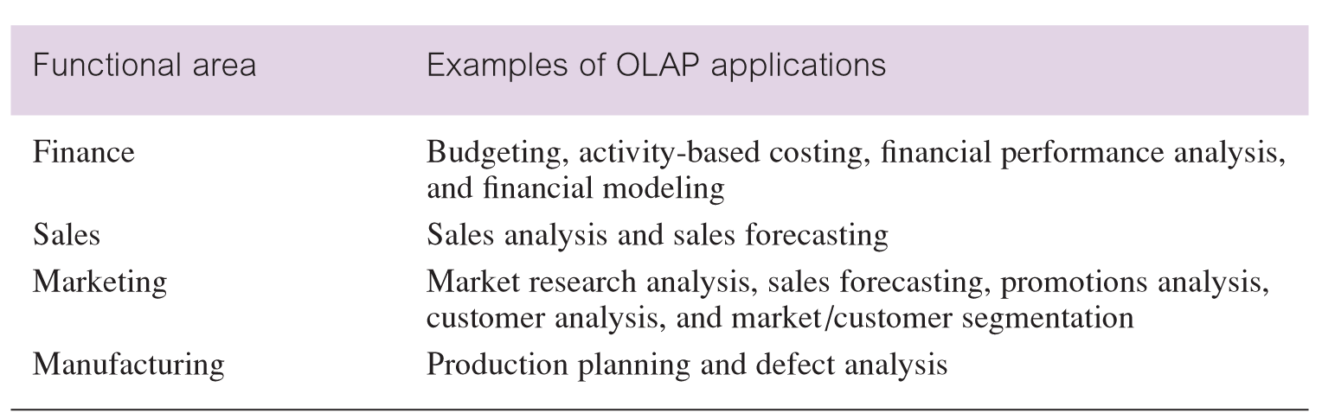
Examples of OLAP applications in various functional areas

Slide 6
OLAP Applications
Although OLAP applications are found in widely divergent functional areas, they all have the following key features:
  multi-dimensional views of data
  support for complex calculations
  time intelligence

Slide 7
OLAP Applications - multi-dimensional views of data
Core requirement of building a ‘realistic’ business model.
Provides basis for analytical processing through flexible access to corporate data.
The underlying database design that provides the multi-dimensional view of data should treat all dimensions equally.

Slide 8
OLAP Applications - support for complex calculations
Must provide a range of powerful computational methods such as that required by sales forecasting, which uses trend algorithms such as moving averages and percentage growth.
Mechanisms for implementing computational methods should be clear and non-procedural.

Slide 9
OLAP Applications – time intelligence
Key feature of almost any analytical application as performance is almost always judged over time.
Time hierarchy is not always used in the same manner as other hierarchies.
Concepts such as year-to-date and period-over-period comparisons should be easily defined.

Slide 10
Multi-dimensional Data and OLAP cubes
Multi-dimensional data is facts (numeric measurements) such as property sales revenue data and the association of this data with dimensions such as location (of the property) and time (of the property sale).
Which is the best representation of multi-dimensional data: relational table, matrix or data cube?

Slide 11
OLAP Tools
There are many varieties of OLAP tools available in the marketplace.
This choice has resulted in some confusion with much debate regarding what OLAP actually means to a potential buyer and in particular what are the available architectures for OLAP tools.

Slide 12
Categories of OLAP Tools
OLAP tools are categorized according to the architecture used to store and process multi-dimensional data.
There are three main categories:
  Multi-dimensional OLAP (MOLAP)
  Relational OLAP (ROLAP)
  Hybrid OLAP (HOLAP)

Slide 13
Multi-dimensional OLAP (MOLAP)
Use specialized data structures and multi-dimensional Database Management Systems (MDDBMSs) to organize, navigate, and analyze data.
Data is typically aggregated and stored according to predicted usage to enhance query performance.

Slide 14
Multi-dimensional OLAP (MOLAP)
Use array technology and efficient storage techniques that minimize the disk space requirements through sparse data management.
Provides excellent performance when data is used as designed, and the focus is on data for a specific decision-support application.

Slide 15
Multi-dimensional OLAP (MOLAP)
Traditionally, require a tight coupling with the application layer and presentation layer.
Recent trends segregate the OLAP from the data structures through the use of published application programming interfaces (APIs).

Slide 16
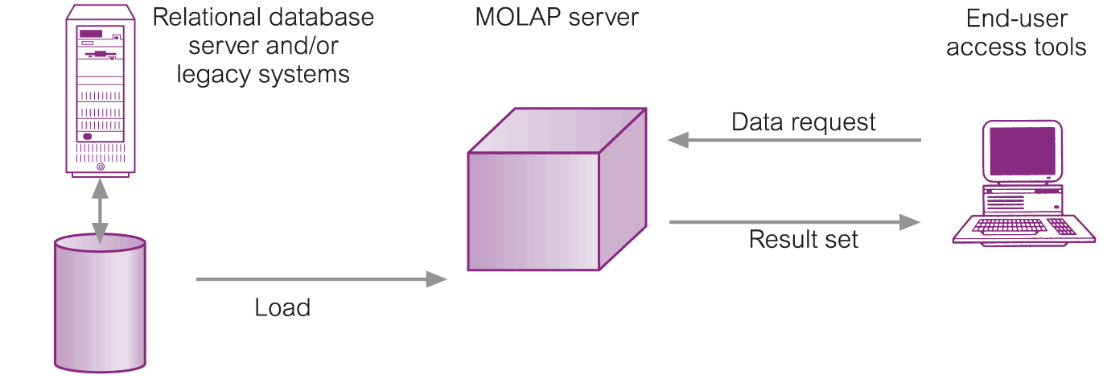
Typical Architecture for MOLAP Tools

Slide 17
MOLAP Tools - Development Issues
Underlying data structures are limited in their ability to support multiple subject areas and to provide access to detailed data.
Navigation and analysis of data is limited because the data is designed according to previously determined requirements.

Slide 18
MOLAP Tools - Development Issues
MOLAP products require a different set of skills and tools to build and maintain the database, thus increasing the cost and complexity of support.

Slide 19
Relational OLAP (ROLAP)
Fastest-growing style of OLAP technology due to requirements to analyze ever-increasing amounts of data and the realization that users cannot store all the data they require in MOLAP databases.

Slide 20
Relational OLAP (ROLAP)
Supports RDBMS products using a metadata layer - avoids need to create a static multi-dimensional data structure - facilitates the creation of multiple multi-dimensional views of the two-dimensional relation.

Slide 21
Relational OLAP (ROLAP)
To improve performance, some products use SQL engines to support the complexity of multi-dimensional analysis, while others recommend, or require, the use of highly denormalized database designs such as the star schema.

Slide 22
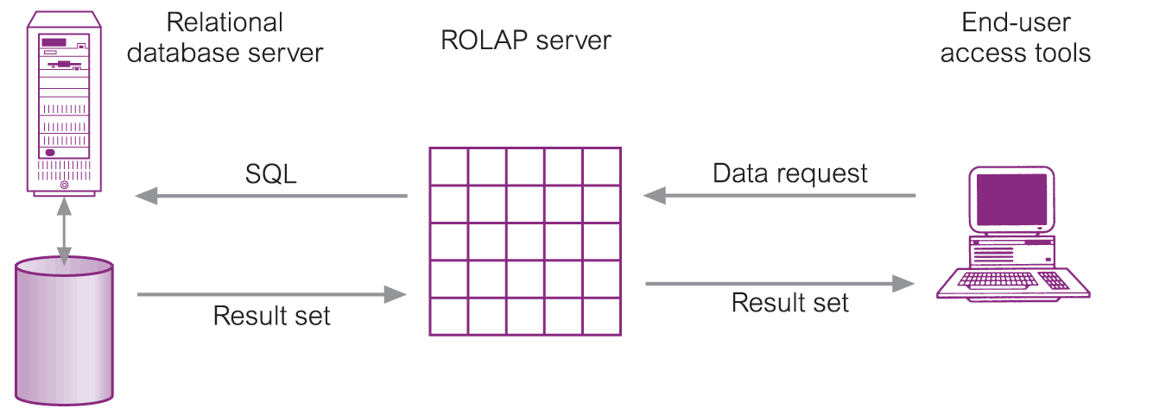
Typical Architecture for ROLAP Tools

Slide 23
ROLAP Tools - Development Issues
Performance problems associated with the processing of complex queries that require multiple passes through the relational data.
Middleware to facilitate the development of multi-dimensional applications. (Software that converts the two-dimensional relation into a multi-dimensional structure).

Slide 24
ROLAP Tools - Development Issues
Development of an option to create persistent, multi-dimensional structures with facilities to assist in the administration of these structures.

Slide 25
Hybrid OLAP (HOLAP)
Provide limited analysis capability, either directly against RDBMS products, or by using an intermediate MOLAP server.
Deliver selected data directly from the DBMS or via a MOLAP server to the desktop (or local server) in the form of a datacube, where it is stored, analyzed, and maintained locally.

Slide 26
Hybrid OLAP (HOLAP)
Promoted as being relatively simple to install and administer with reduced cost and maintenance.

Slide 27
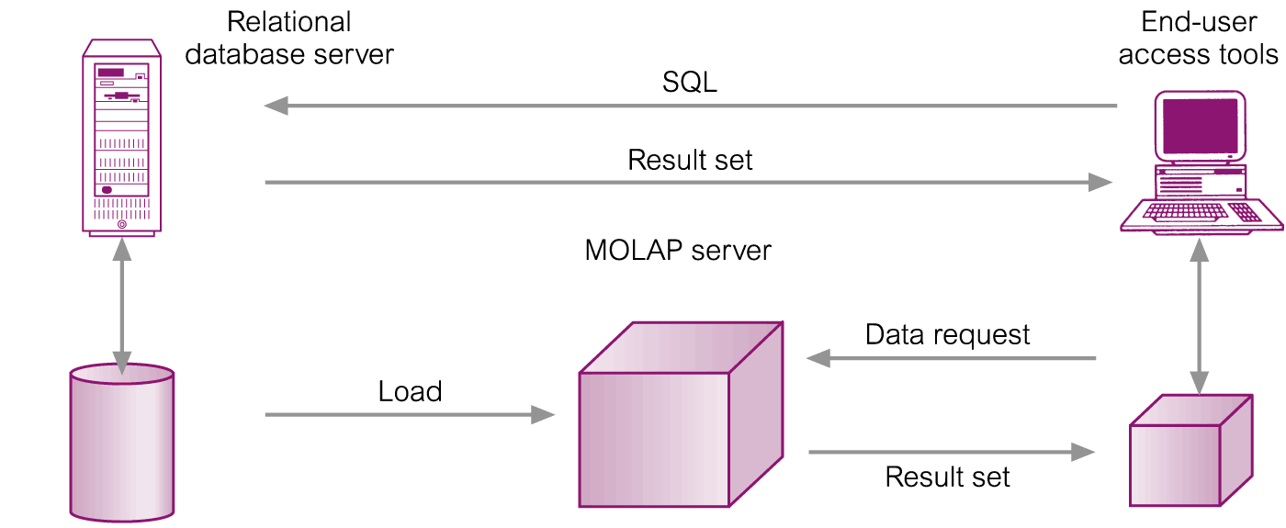
Typical Architecture for HOLAP Tools

Slide 28
HOLAP Tools - Development Issues
Architecture results in significant data redundancy and may cause problems for networks that support many users.
Ability of each user to build a custom datacube may cause a lack of data consistency among users.
Only a limited amount of data can be efficiently maintained.

Slide 29
Desktop OLAP (DOLAP)
Store the OLAP data in client-based files and support multi-dimensional processing using a client multi-dimensional engine.
Requires that relatively small extracts of data are held on client machines. They may be distributed in advance, or created on demand (possibly through the Web).

